Slide 1

By Elke Hansen

Slide 2

Get closer than ever to your customers. So close that you tell them what they need well before they realize it themselves. ~ Steve Jobs
Notes:
If you have in depth knowledge of who your current and potential customers are, you have already won half the battle.

Slide 3
Customer Relationship Management Software
Loyalty Programs of Value
Recommendation Engine
Targeted Marketing
Customer Database
Sales Forecasting for Buying
Promotional Optimisation
Store Allocation
Loss Prevention
How? Machine Learning!
Notes:
From this, I had several ideas for models that can be created from a good customer database:

Slide 4
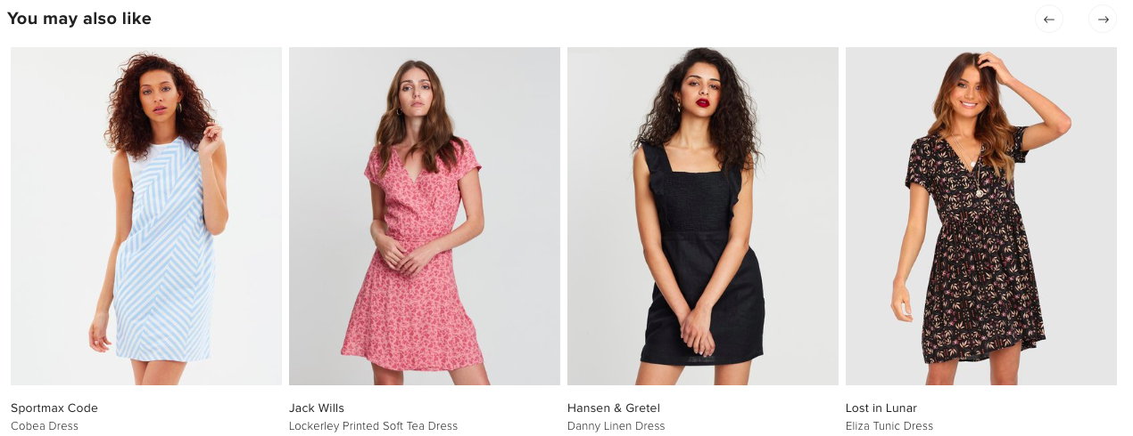
Problem Statement
* Customers have too many choices in a modern retail market
* There is a strong need for taste curation and suggestions
* How can retailers use data to improve user experiences, create customer satisfaction and retain brand loyalty?

Slide 5
Recommendation Engines
Pros:
Range from simple to complex
Easy to implement
Continue to improve over time
Increased consumption and higher profits
Reduce customer churn
Cons:
Require a large amount of data storage and infrastructure
Initial calculation processing
Require regular maintenance
Fun Fact:
Amazon make 35% of their sales through recommendations

Slide 6
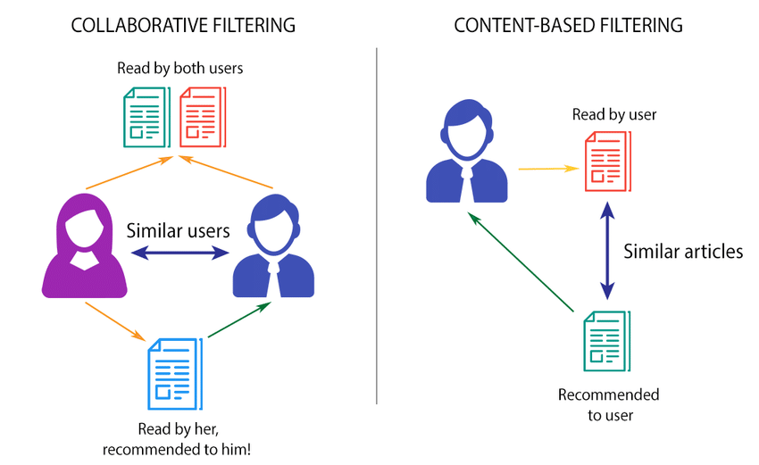
How Does It Work?
Collaborative filtering:
- Needs a large amount of customer data
Content-based Filtering:
- Needs a large amount of product based data
As you get more information about customer, transition from content based to collaborative

Slide 7
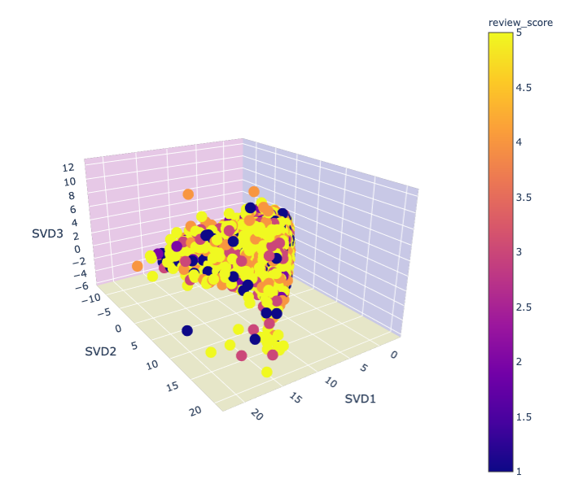
Key Concepts
Customers versus products in 3D
Project the products into multi-dimensional space based on their common customers :
- TFIDF Vectorizer
- Truncated SVD
Measure the angle between each customer
- Cosine Similarity
Store each products similarities in a database
Recommend products based on what their most similar products customers have purchased

Slide 8
Future Challenges:
Further develop strategy to incorporate future sales
Combination of models for increased complexity
Creation of web based application
Challenges:
Dataset: not a large amount of customer purchases
Figuring out how to fit the results of other models into the recommendation model
Volume of data and calculation times

Slide 9
Questions?

